Slide 1
A Simple Plan for INTERCESSORY PRAYER
General Conference
Women’s Ministries

Slide 2
For I know the plans I have for you," declares the LORD, "plans to prosper you and not to harm you, plans to give you hope and a future. Then you will call upon me and come and pray to me, and I will listen to you. You will seek me and and me when you seek me with all your heart.
Jeremiah 29:11-13

Slide 3
SUGGESTIONS FOR A PRAYER PLAN
DAILY MEALS WITH GOD
Begin the day with devotions at breakfast, preparing your heart before God with the first six steps. Then use your meal times for the intercessory steps. At lunch focus on people, and at supper focus on leaders. If you have a family, you could pray around the table, assigning a person to lead in prayer for each of three steps.

Slide 4
SUGGESTIONS FOR A PRAYER PLAN
HOURLY INTERCESSION the day with devotions and walking through the first six steps of personal preparation. Spend at least 3 minutes on each for 18 minutes of personal preparation. At work, set your watch alarm to go off at the top of each hour. Spend the first 3-5 minutes of each hour in an intercessory step.

Slide 5
Morning Preparation
MORNING PREPARATION | HOURLY INTERCESSION
Be Still | 9 am - Souls
Be Worshipful | 10 am - Saints
Be Thankful | 11 am - Sick
Confession | 1 pm - Ministers
Clothe in Armor | 2 pm - Missionaries
Cast Cares | 3 pm - Magistrates

Slide 6
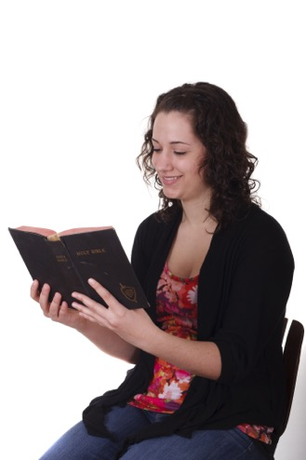
SUGGESTIONS FOR A PRAYER PLAN
WEEKDAY INTERCESSION
Every day use the first six steps of personal preparation to prepare your heart for intercession. Then daily use one step of intercession as the focus of your intercession for that day.

Slide 7
DAILY PREPARATION | WEEKDAY INTERCESSION
Be Still | Monday - Souls
Be Worshipful | Tuesday - Saints
Be Thankful | Wednesday - Sick
Confession | ursday - Ministers
Clothe in Armor | Friday - Missionaries
Cast Cares | Saturday - Magistrates

Slide 8
Other Ways to Use These Steps

Slide 9
One Hour Daily Prayer-Begin each day quietly before God with the time of preparation. Do not be in a hurry. Allow 36 minutes or a one-hour period (either morning, afternoon, or evening) to be quiet, undisturbed and unhurried before God. When your heart is quiet and prepared, then do the Six Steps of Intercession.

Slide 10
Half-Day of Prayer - Once a week it is beneficial to spend a half-day of fasting prayer with God, from 6 a.m. to 12 noon if at all possible. Use the Steps, spending a half hour on each. For variety you may wish to mix them up rather than doing them in order. Give yourself a 10 minute break each hour or a 5 minute break each half hour.

Slide 11
Monthly Personal Retreat - Every month plan to spend a day and a half in intercessory prayer, perhaps the first or last Monday evening and Tuesday of the month. If possible, go to a local retreat center for an overnight with God so as to have no distractions. Use the Steps of Prayer for 12 hours of intercession—one hour for each. Include a 10 minute break each hour, and begin each hour with the first three steps.

Slide 12
Prayer Groups/Partners -With your prayer partner or a small group of people, walk through the Steps of Prayer together. Each of you offers God a sentence or two on each Step as the Spirit leads. Praying with a partner or small group can be refreshing.

Slide 13
Whole Church Prayer Concerts - A concert of prayer is a partial day dedicated to prayer in the church.

Slide 14
The Day-Long Intercessor

Slide 15
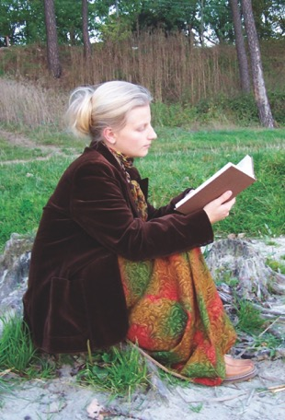
TOP OF EVERY HOUR
At the top of every hour, begin a new step of intercession. This keeps one focused and moving along in the intercessory prayer time.

Slide 16
FIRST 10 MINUTES
The first 10 minutes are preparatory, a time to use the first 3 steps of stillness, worship, and thanksgiving.

Slide 17
40 MINUTES OF INTERCESSION
Each hour is composed of a solid 40 minutes of intercession on the step at hand.

Slide 18
LAST TEN MINUTES
Use the last 10 minutes of every hour for a break. You are only human and need to break your routine to keep from weariness. Take a bathroom break, or a tea or juice break.

Slide 19
A One Day Prayer Retreat
Extended prayer retreats alone with God are both biblical and helpful in developing an intimate relationship with God. God longs to walk with you in the cool of the day as He did with Adam. But we rarely spend time with Him, and when we do, we are often in a hurry to get on to other activities. We need to take time to be holy.

Slide 20
If possible, it is beneficial to set aside one day a month for prayer. Here is a simple guide for a day of prayer. You may find it helpful to go away to a solitary place. Some find it helpful, even necessary to do an overnight in order to be relaxed to start the day.

Slide 21
Suggested Schedule
7 am – Simple Breakfast
8 am – Be still (1) Be Worshipful (2) Be (3)Thankful
9 am – Confession (4) Clothe in Armor(5) Cast your Care (6)
10 am – Walk & listen to sermon tape/music, etc
11 am – Intercession: Souls (7) Your top 10 list
12 am – Lunch – A light lunch (read a devotional book)
1 pm – Intercession: Saints (8) Your church phone list

Slide 22
2 pm – Break! (Nap or take a walk)
3 pm – Intercession: Sick (9) the afflicted in mind, soul body
4 pm – Praises with tapes (walk, journal, plan)
5 pm – Intercession: Ministers (10)
6 pm – Supper break - Listen to Scripture on tape or sing
7 pm – Intercession: Missionaries (11) Use Prayer Cards
8 pm – Walk w/ prayer (Music /Silence or Sermon)
9 pm – Intercession: Magistrates (12) Use a Newspaper
10 pm – Meditation on God’s Name, Acts, Worth
11 pm – Return home (or bed) with Praise Tapes or singing

Slide 23
Remember, prayer is fellowship with God, not just bending God’s ear with a list of requests. Those who “know their God” shall be strong and do exploits. Get to know God in prayerful listening, whispering, singing, worshipping, reading, meditating, memorizing His word, etc.

Slide 24
This is one suggestion for an ordered and disciplined time of extended prayer. Some may find it difficult or unrewarding to be so disciplined. Feel free to develop your own style. Just be sure that it keeps you praying.

Slide 25
A Guide to Intercessory Prayer
FOCUS ON GOD
Personal Intimacy
Be Still
Be Worshipful
Be Thankful

Slide 26
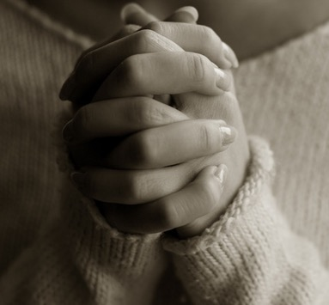
FOCUS ON YOU
Private Inspection
Confession
Clothe in Armor
Cast Your Care

Slide 27
FOCUS ON OTHERS
Intercession for Friends
Discouraged
Facing challenges
Sick

Slide 28
FOCUS ON WORLD
Intercession for Leaders
Ministers
Missionaries
Magistrates

Slide 29
For I know the plans I have for you," declares the LORD, "plans to prosper you and not to harm you, plans to give you hope and a future. Then you will call upon me and come and pray to me, and I will listen to you. You will seek me and and me when you seek me with all your heart.
Jeremiah 29:11-13

